Slide 1
Introduction to JavaScript I
Week 03.

Slide 2
Objectives
Describe the basic syntax of JavaScript;
Describe the data types, conditional statements, and loops in JavaScript;
Demonstrate how to write scripts in web page using JavaScript.

Slide 3
Tools Required
Visual Studio Code
Browser
Google Chrome (recommended)
Mozilla Firefox

Slide 4
Javascript (JS)

Slide 5
A Brief History of JavaScript
1995: At Netscape, Brendan Eich created "LiveScript", which gets renamed to "JavaScript".
1996: Microsoft releases "JScript", a port, for IE3.
1997: JavaScript was standardized in the "ECMAScript" spec.
2005: "AJAX" was coined, and the web 2.0 age begins.
2006: jQuery 1.0 was released.
2010: Node.JS was released.
2012: ECMAScript Harmony spec nearly finalized.

Slide 6
What can JavaScript do?
Image switchers and lightboxes
Full featured web applications
Keep track of users with cookies
Interactive elements like tabs, sliders and accordions
Drawing and animation
Mind blowing awesomeness like this

Slide 7
Browsers + JavaScript Consoles
Google Chrome
Console
Chrome Canary: Developer version of Chrome
Firefox
Firebug (Add-on)
Safari
Console: Web Inspector (need to enable Developer mode in Preferences -> Advanced)
Webkit Nightly: Developer version
Internet Explorer
F12 Developer Tools

Slide 8
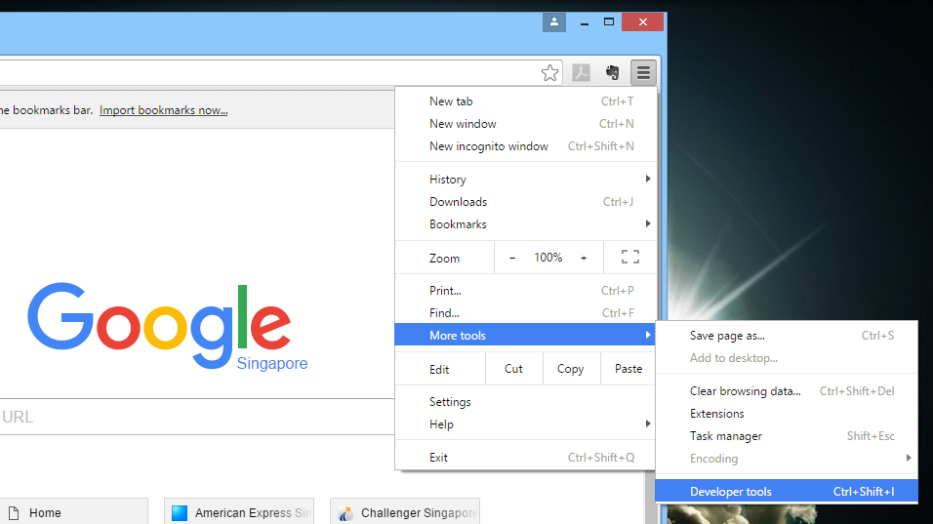
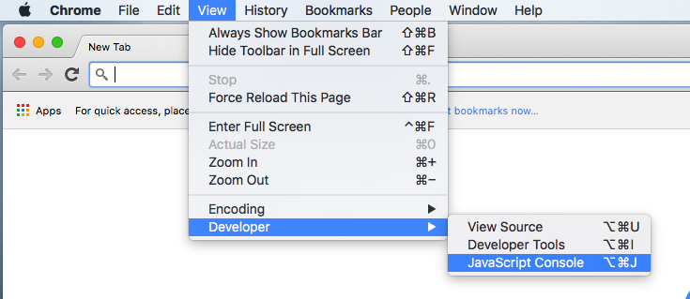
JavaScript Console (Chrome)
You will use a browser built-in tool called JavaScript Console to help you learn JavaScript.
Mac OS X
Windows

Slide 9
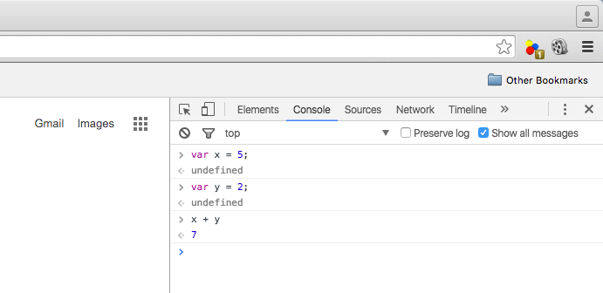
JavaScript Console (Chrome)

Slide 10
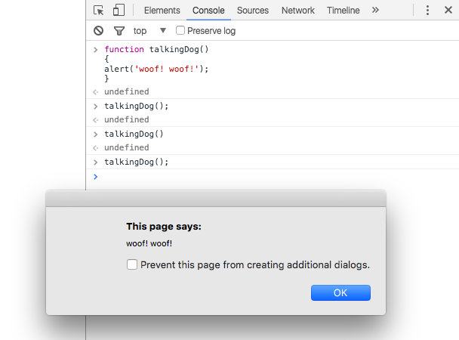
JavaScript Console (Chrome)
You can also write functions in the console.
Type Shift-Enter to go to new line.

Slide 11
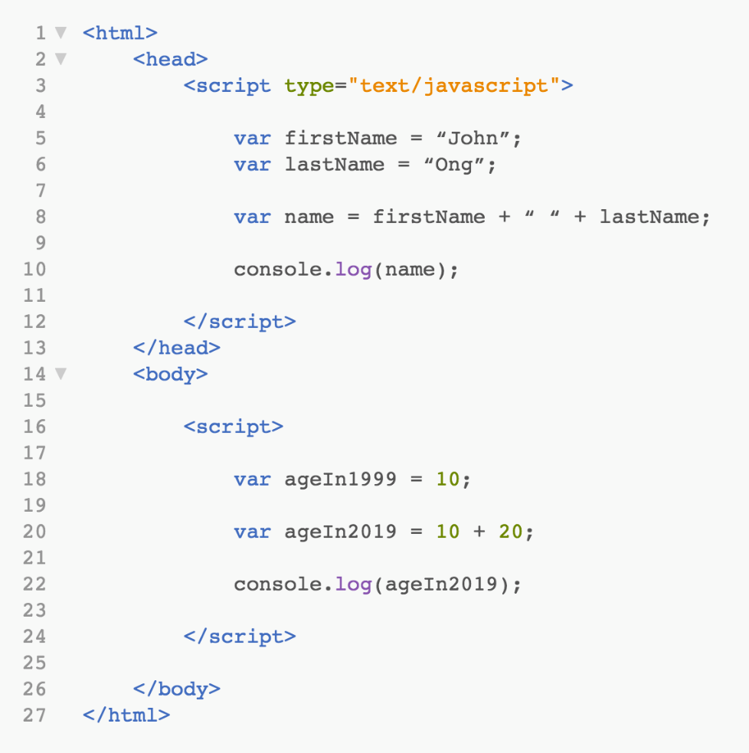
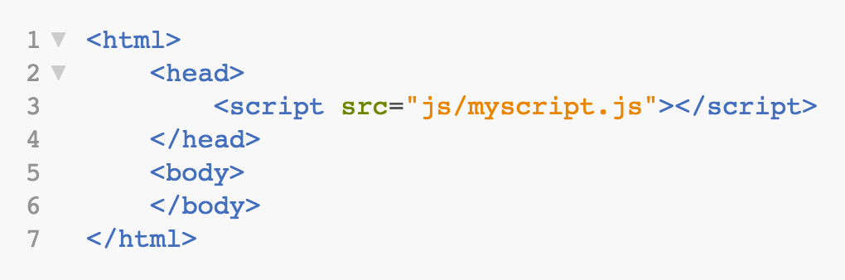
How to Use JavaScript?
In Script Tag Within
Head/Body Tag
Link to External File

Slide 12
JavaScript References
W3Schools
http://www.w3schools.com/js/default.asp
Mozilla Developer Network
http://developer.mozilla.org/en-US/docs/Web/JavaScript
JavaScript: The Good Parts by Douglas Crockford
Google: Chrome Developer Tools
http://developers.google.com/chrome-developer-tools
Firefox: Firebug Wiki
http://getfirebug.com/wiki

Slide 13
Variables and funcTions

Slide 14
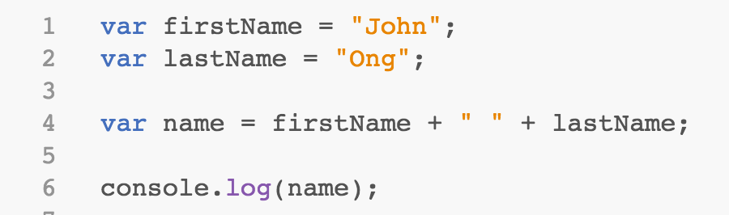
Variables
JavaScript is similar to Java in syntax
JavaScript is loosely typed i.e. no need to declare variable type
Use “var” to create and declare variables.
Use “console.log()” to output to the console.

Slide 15
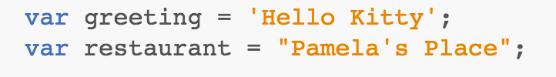
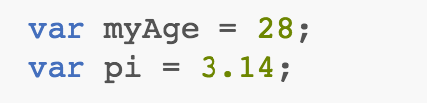
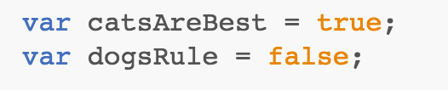


Primitive Data Types
string: an immutable string of characters
number: whole or decimal point
boolean: represents logical values true or false
undefined: represents a value that has not been defined
null: represents an explicitly empty value

Slide 16
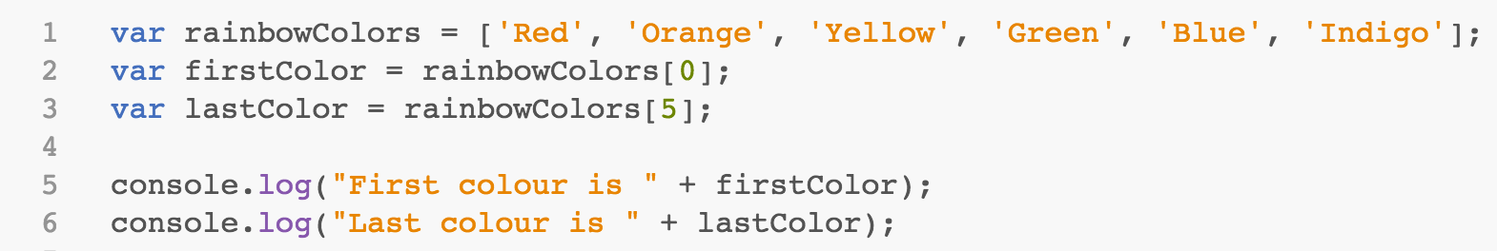
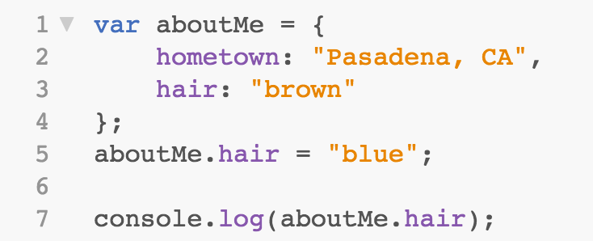
Other Data Types
array: a collection of items
object: represents custom built objects or built-in objects such as windows, document, etc…

Slide 17
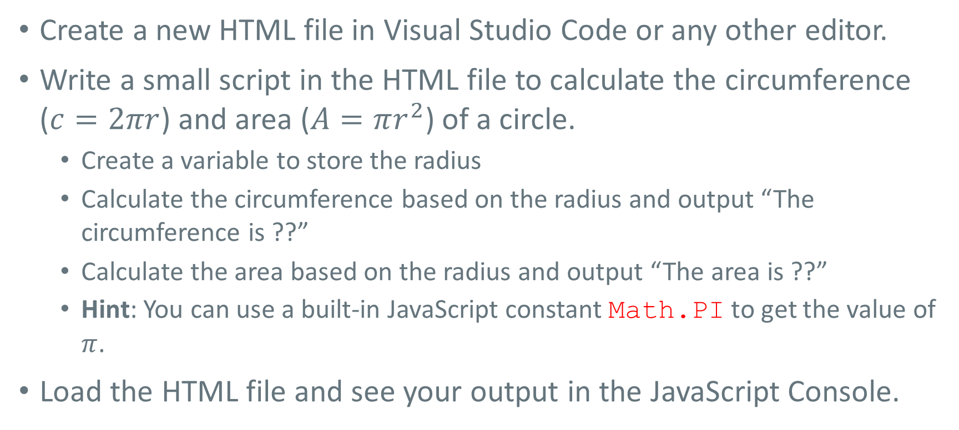
Try It Out! (Part 1)
Create a new HTML file in Visual Studio Code or any other editor.
Write a small script in the HTML file to calculate the circumference ($c=2πr$) and area ($A=πr^{2}$) of a circle.
Create a variable to store the radius
Calculate the circumference based on the radius and output “The circumference is ??”
Calculate the area based on the radius and output “The area is ??”
Hint: You can use a built-in JavaScript constant Math.PI to get the value of $π$.
Load the HTML file and see your output in the JavaScript Console.
Notes:
var radius = 3;
var circumference = Math.PI * 2*radius;
console.log("The circumference is " + circumference);
var area = Math.PI * radius*radius;
console.log("The area is " + area);

Slide 18
Try It Out! (Part 2)
Create a new JavaScript file in Visual Studio Code or any other editor. The file must end with “.js” extension. E.g. myscript.js
Copy the script that you wrote previously to your JavaScript file.
In the previous HTML file, remove the JavaScript source codes and replace with a link to your JavaScript file in the script tag.
Load the HTML file in the browser and see your output in the JavaScript Console.

Slide 19
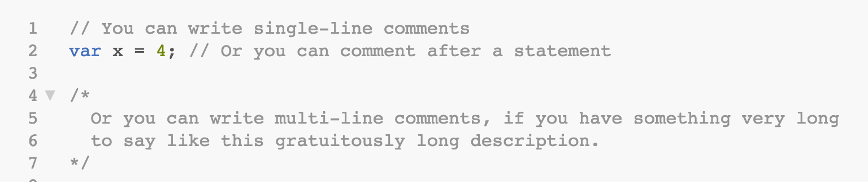
Comments

Slide 20
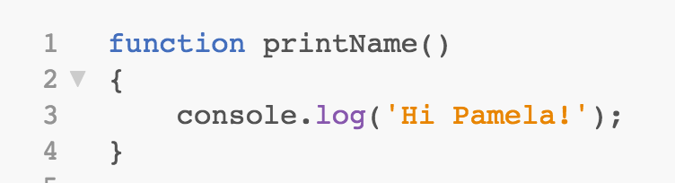

Functions
Methods are called Functions in JavaScript.
A function is created using the keyword “function”.
After the function is created, you use it by calling its name.

Slide 21
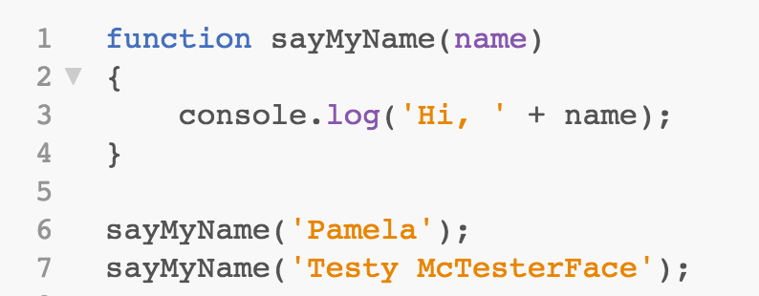
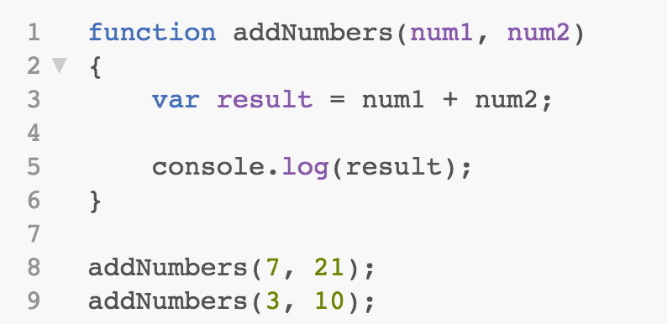
Functions: Arguments
Functions can accept any number of named arguments.

Slide 22
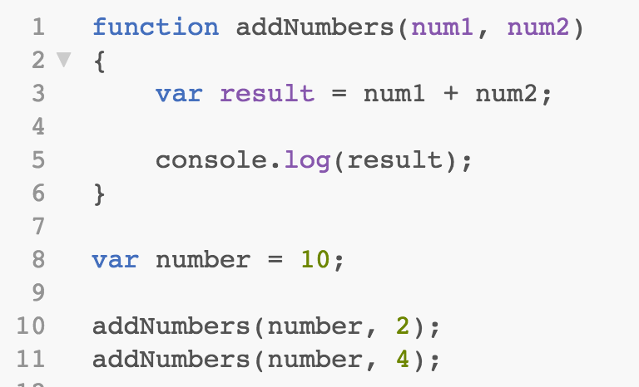
Functions: Variable Passing
You can also pass variables into functions.

Slide 23
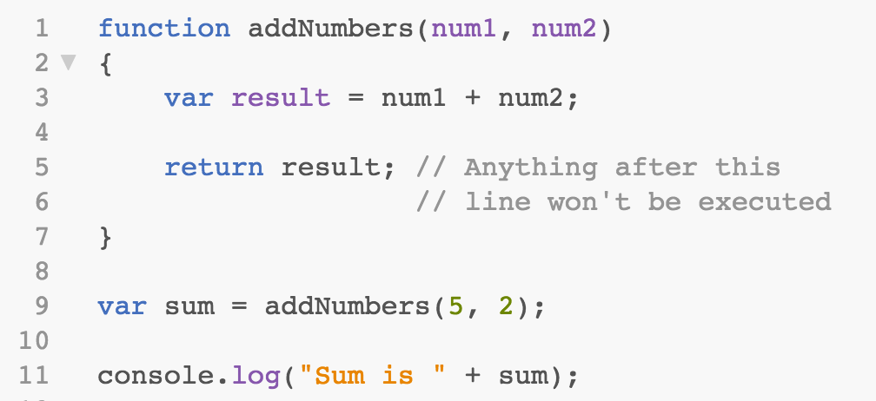
Functions: Return Values
The return keyword returns a value of the function (and exits the function).
You can use function calls in expressions.
You can even call functions inside function calls.

Slide 24
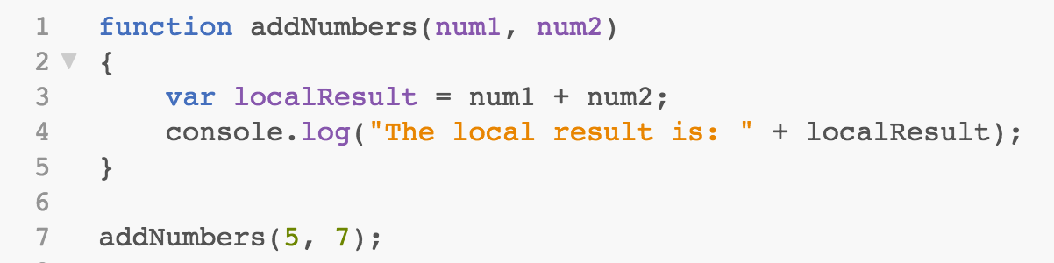
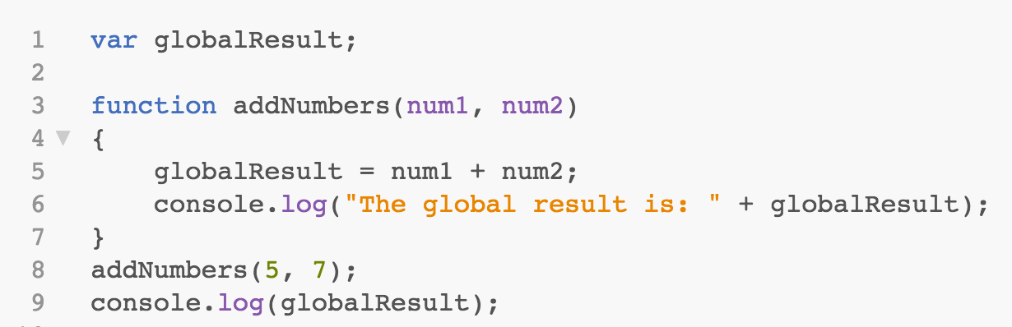
Variable Scope
JS Variables have "function scope". They are visible in the function where they're defined.
A variable with local scope.
A variable with global scope.

Slide 25
Try It Out!
In the JavaScript file that you created previously, write two functions:
one to calculate the circumference of a circle;
and another to calculate the area of a circle.
Each of your functions should output the result to the console in a proper sentence.
Reload your HTML file to see the result.
Notes:
function calcCircumference(radius)
{
var circumference = Math.PI * 2*radius;
console.log("The circumference is " + circumference);
}
function calcArea(radius)
{
var area = Math.PI * radius*radius;
console.log("The area is " + area);
}

Slide 26
Control Statements

Slide 27
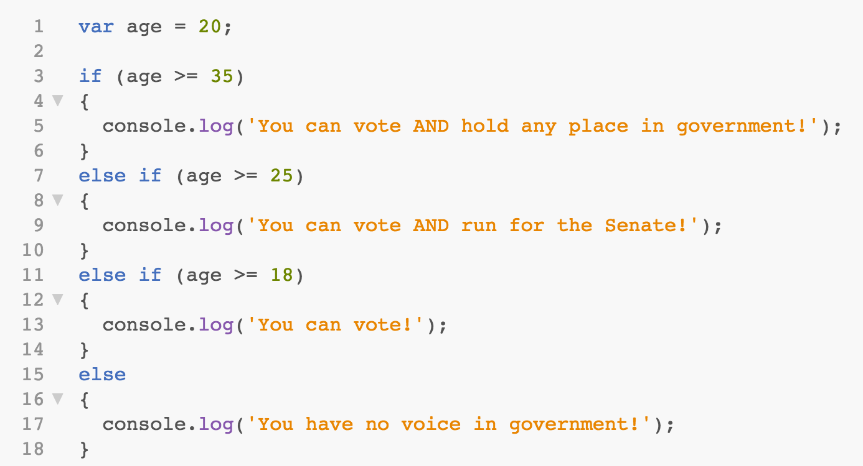
Conditions: if Statement
Notes:
Example of prototyping

Slide 28
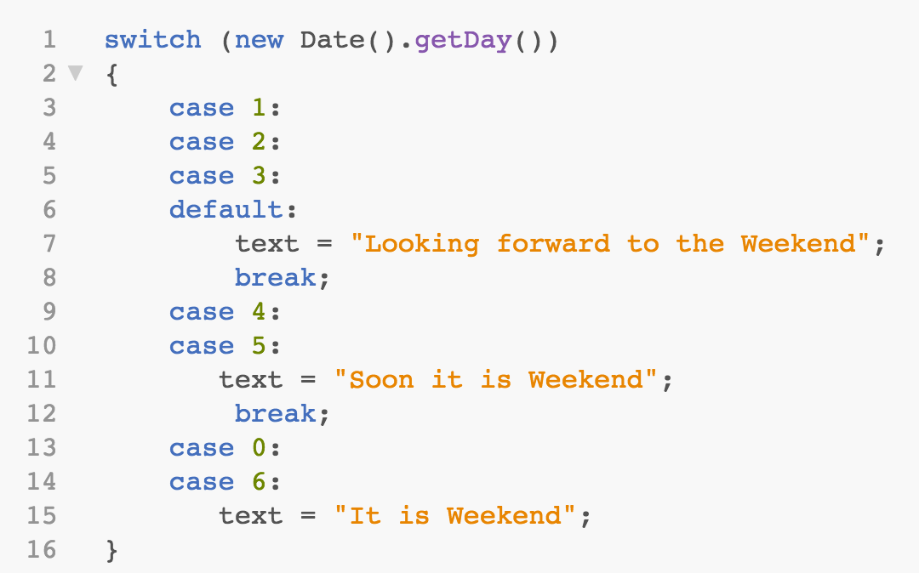
Conditions: switch Block
The “default” case does not have to be the last case in a switch block.

Slide 29
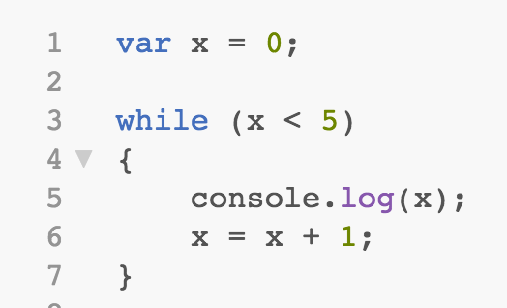
Loops: while
Notes:
Example of prototyping

Slide 30
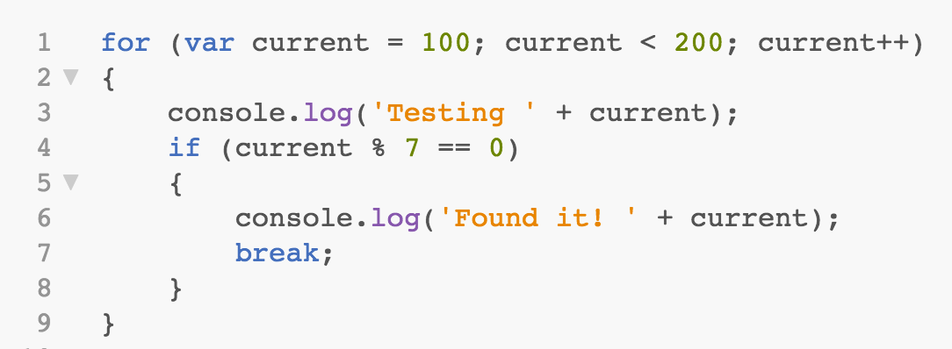
Loops: for
Use “break” to exit a loop.

Slide 31
The End

